Slide 1
Airflow

Slide 2
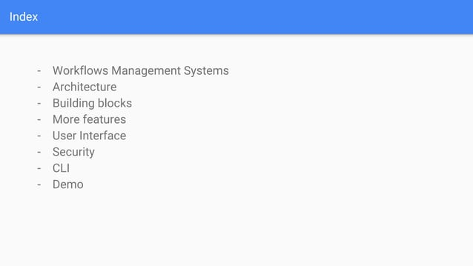

Slide 3
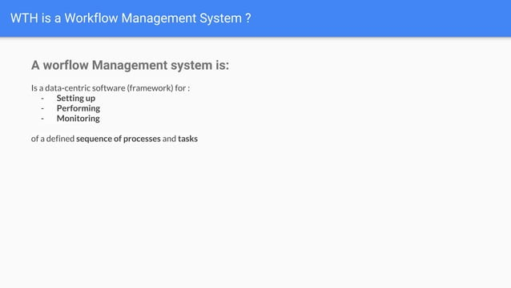

Slide 4
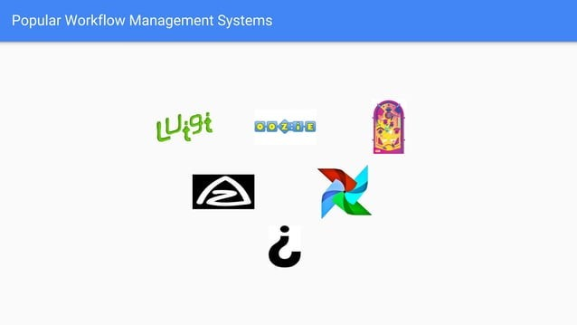

Slide 5


Slide 6
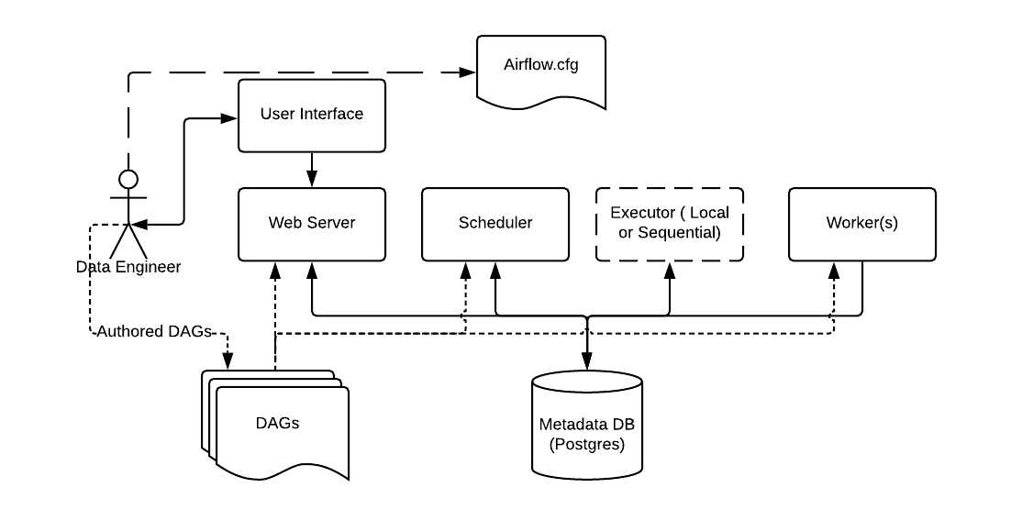
Metadata Database: Airflow uses a SQL database to store metadata about the data pipelines being run. In the diagram above, this is represented as Postgres which is extremely popular with Airflow. Alternate databases supported with Airflow include MySQL.
Web Server and Scheduler: The Airflow web server and Scheduler are separate processes run (in this case) on the local machine and interact with the database mentioned above.
The Executor in reality it is NOT a separate process, but run within the Scheduler.
The Worker(s) are separate processes which also interact with the other components of the Airflow architecture and the metadata repository.
airflow.cfg is the Airflow configuration file which is accessed by the Web Server, Scheduler, and Workers.
DAGs refers to the DAG files containing Python code, representing the data pipelines to be run by Airflow. The location of these files is specified in the Airflow configuration file, but they need to be accessible by the Web Server, Scheduler, and Workers.

Slide 7
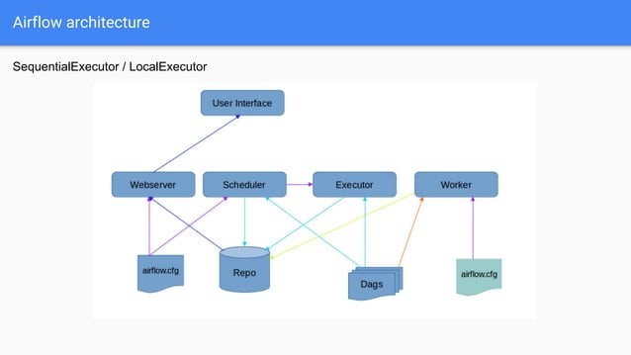

Slide 8
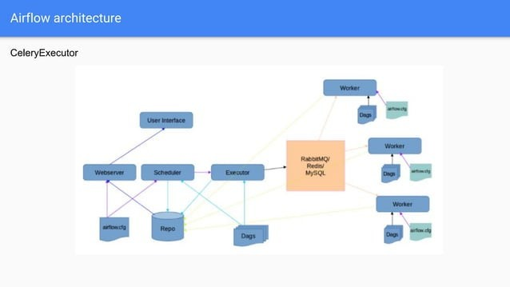

Slide 9
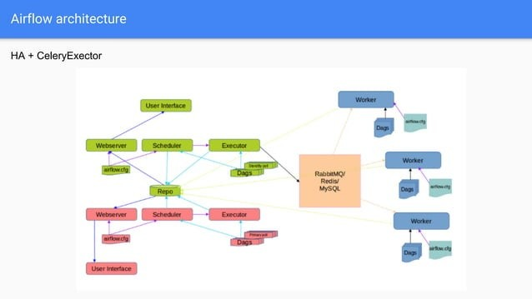

Slide 10


Slide 11
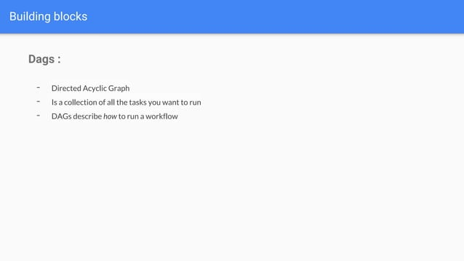

Slide 12
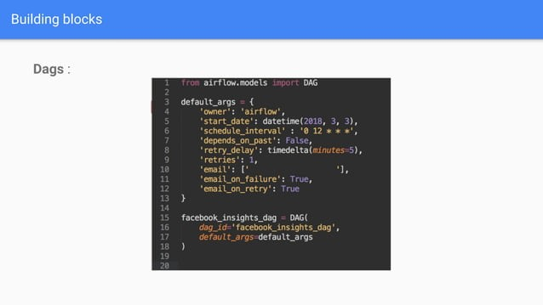
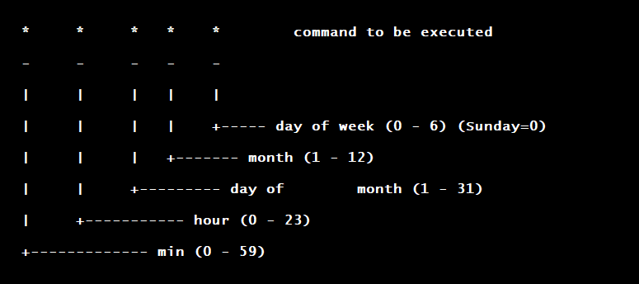

Slide 13
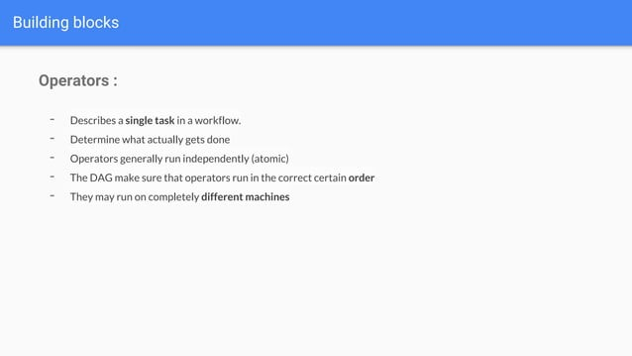

Slide 14
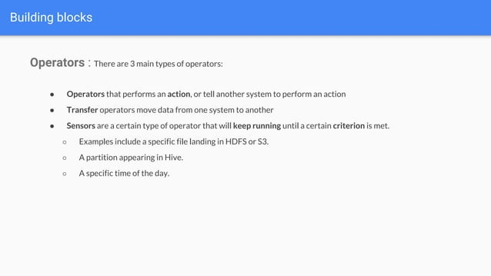

Slide 15
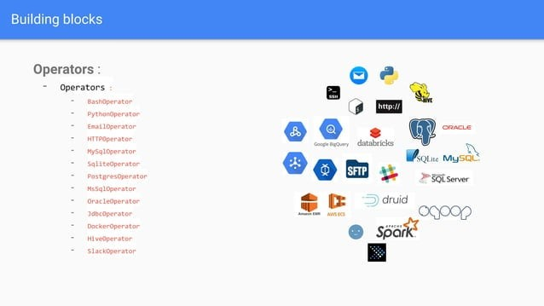

Slide 16
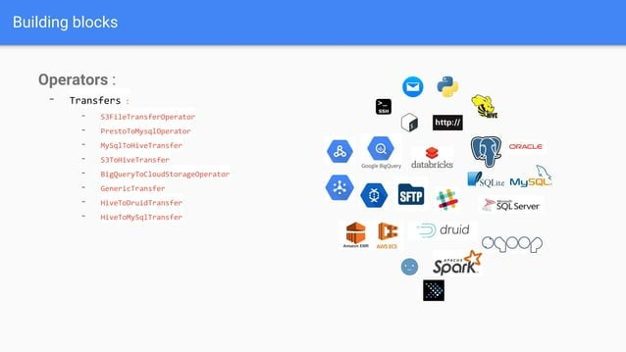

Slide 17


Slide 18
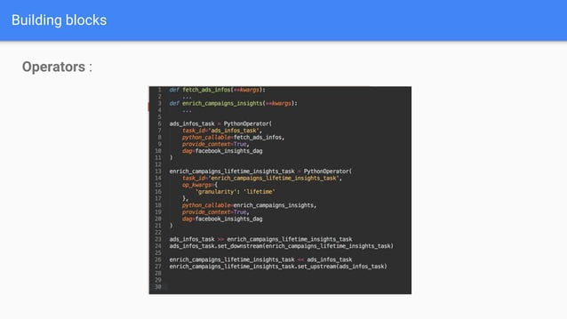

Slide 19
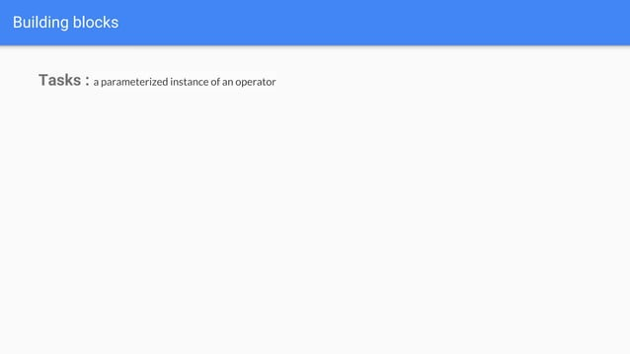

Slide 20
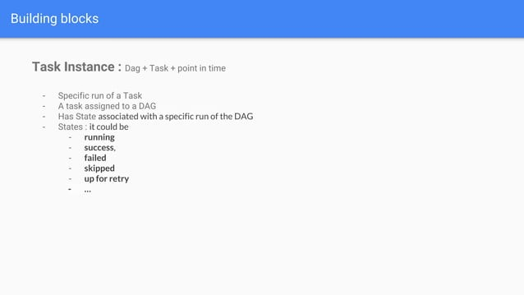

Slide 21
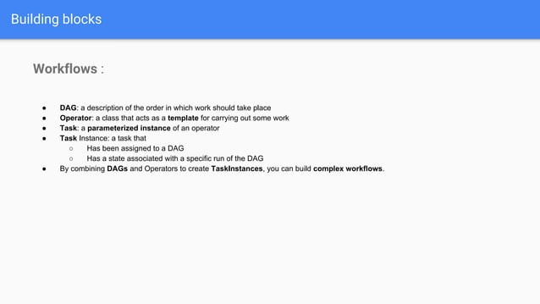

Slide 22


Slide 23
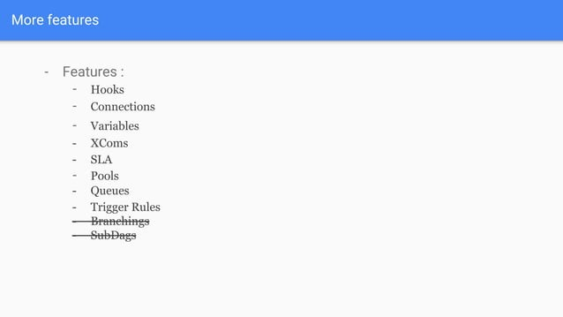

Slide 24
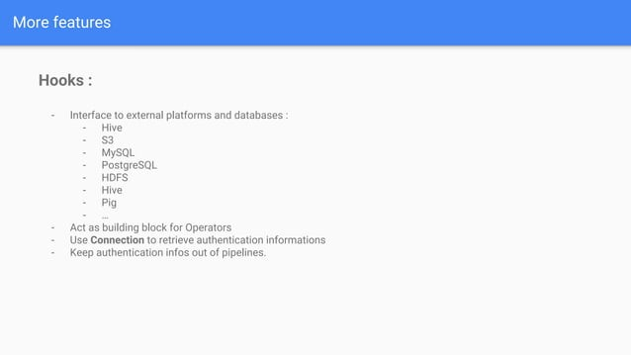

Slide 25
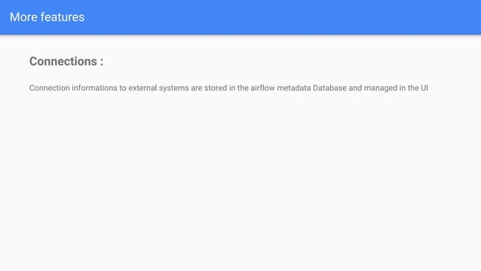

Slide 26
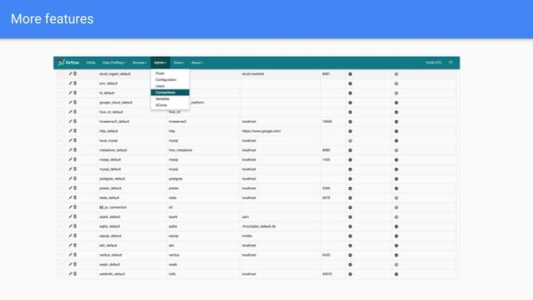

Slide 27
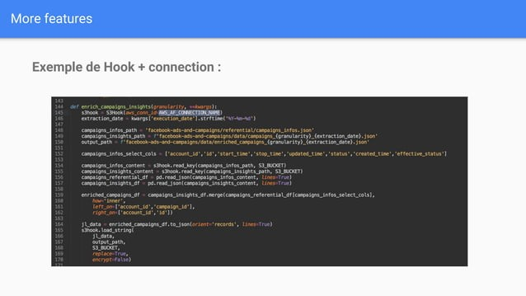

Slide 28
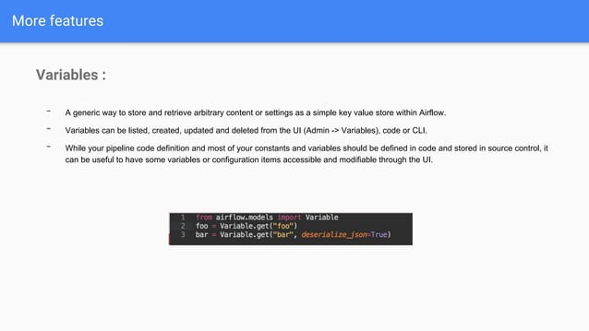

Slide 29
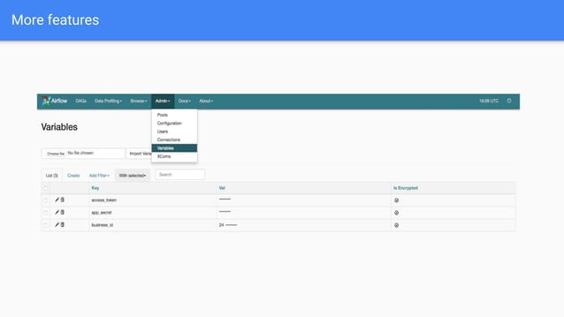

Slide 30
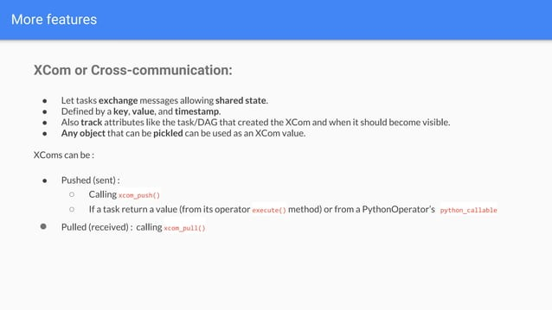

Slide 31
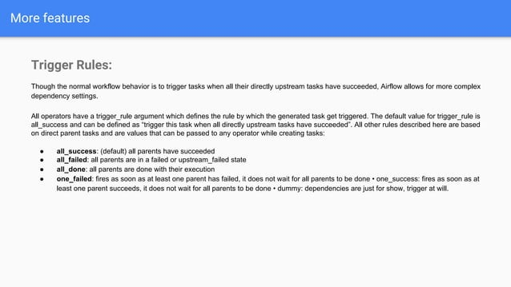

Slide 32
Big Query Operator
https://airflow.apache.org/docs/apache-airflow-providers-google/stable/operators/cloud/bigquery.html

Slide 33


Slide 34
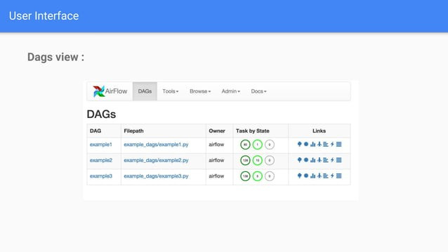

Slide 35
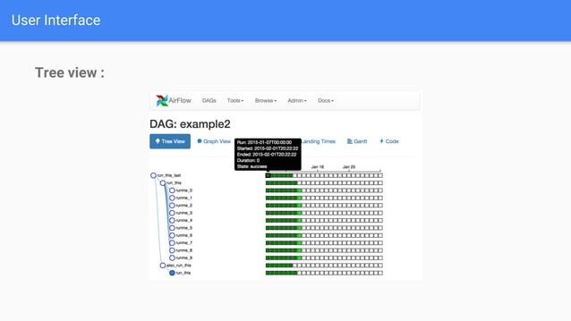

Slide 36
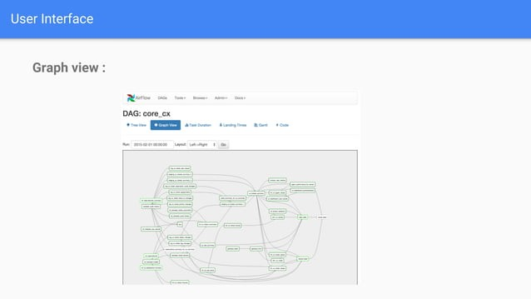

Slide 37
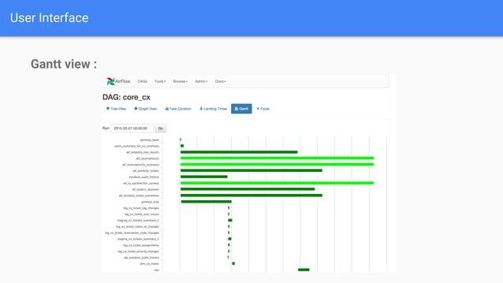

Slide 38
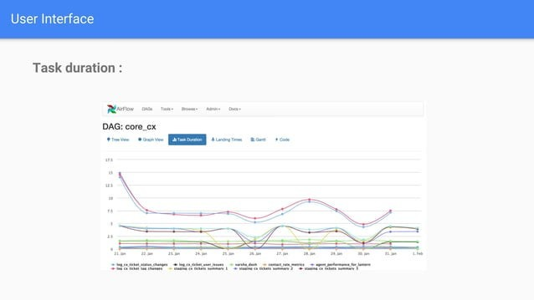

Slide 39


Slide 40
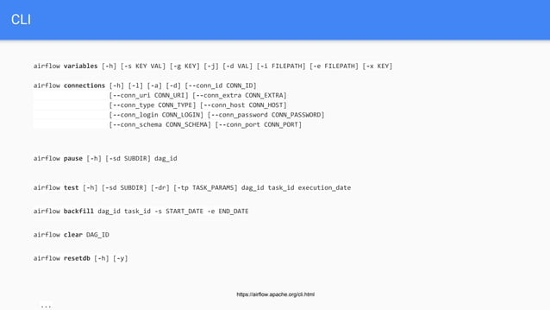

Slide 41


Slide 42
